Slide 1



TEAM 1
AUGUST 2024
PROJECT
TECHNIKON
Aristeridis Alexandros
Andreopoulos Giannis
Chaidou Elena

Slide 2




HOW WE WORKED
Team Work
Giannis
Elena
Alexandros
Project Analysis & Design
Services
Use Cases
GitHub
Property Owner Management
Owner Repository
Property Management
Property Repository
Repair Management
Repair Repository

Slide 3

Our project implements an application for a Renovation Contractor Agency, Technikon.
These are the use cases that have been implemented:
Data population
Owner Registration
Repair Registration
Repair Administration
Reports

Slide 4

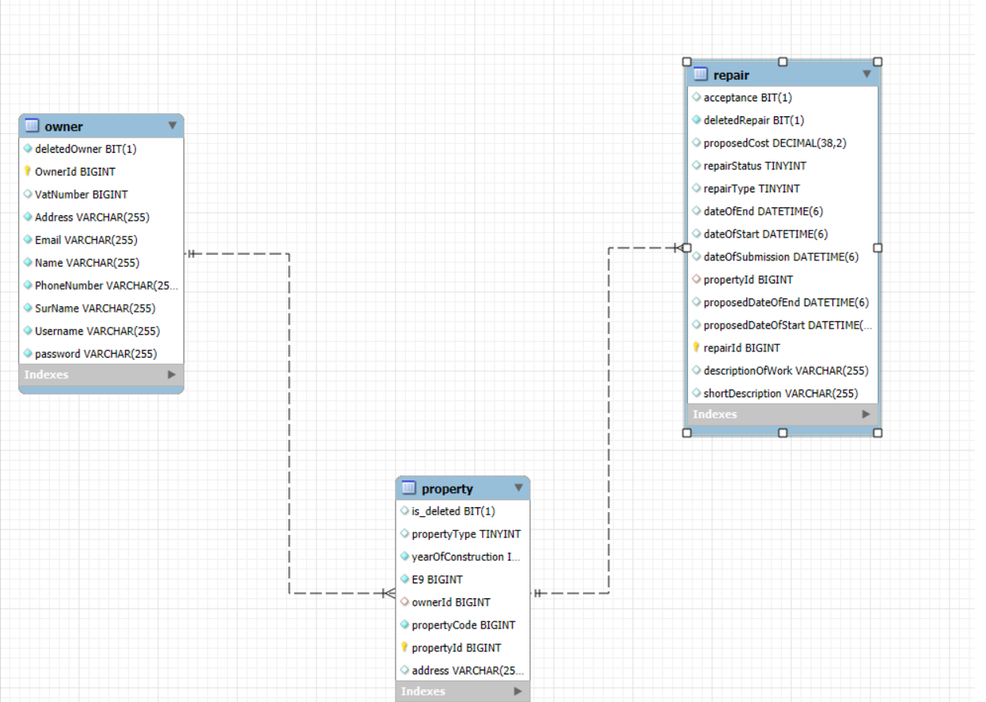
ER DIAGRAM

Slide 5
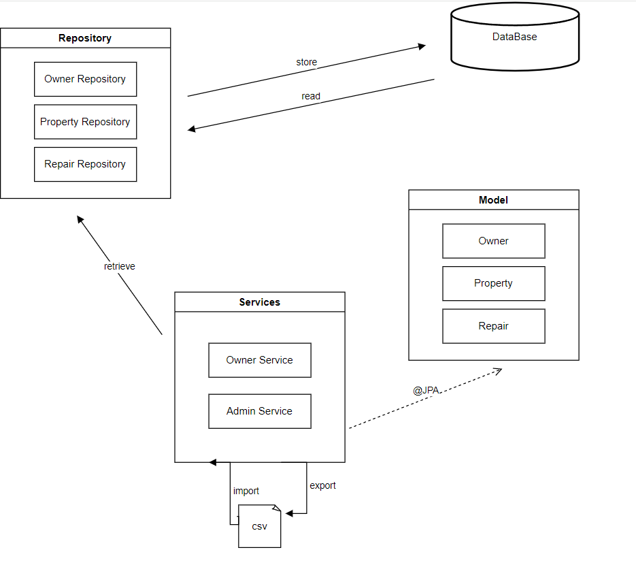
ARCHITECTURE

Slide 6
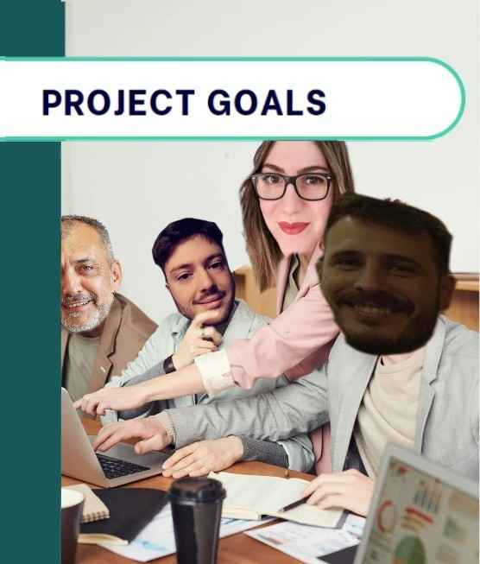

1
Collaborate in a Team Environment
PROJECT GOALS
2
Utilize GitHub for Version Control and Collaboration
3
Apply Course Learnings to a Real-World Project
4
Develop a Functional and Scalable Application
5
Enhance Problem-Solving and Critical Thinking Skills

Slide 7
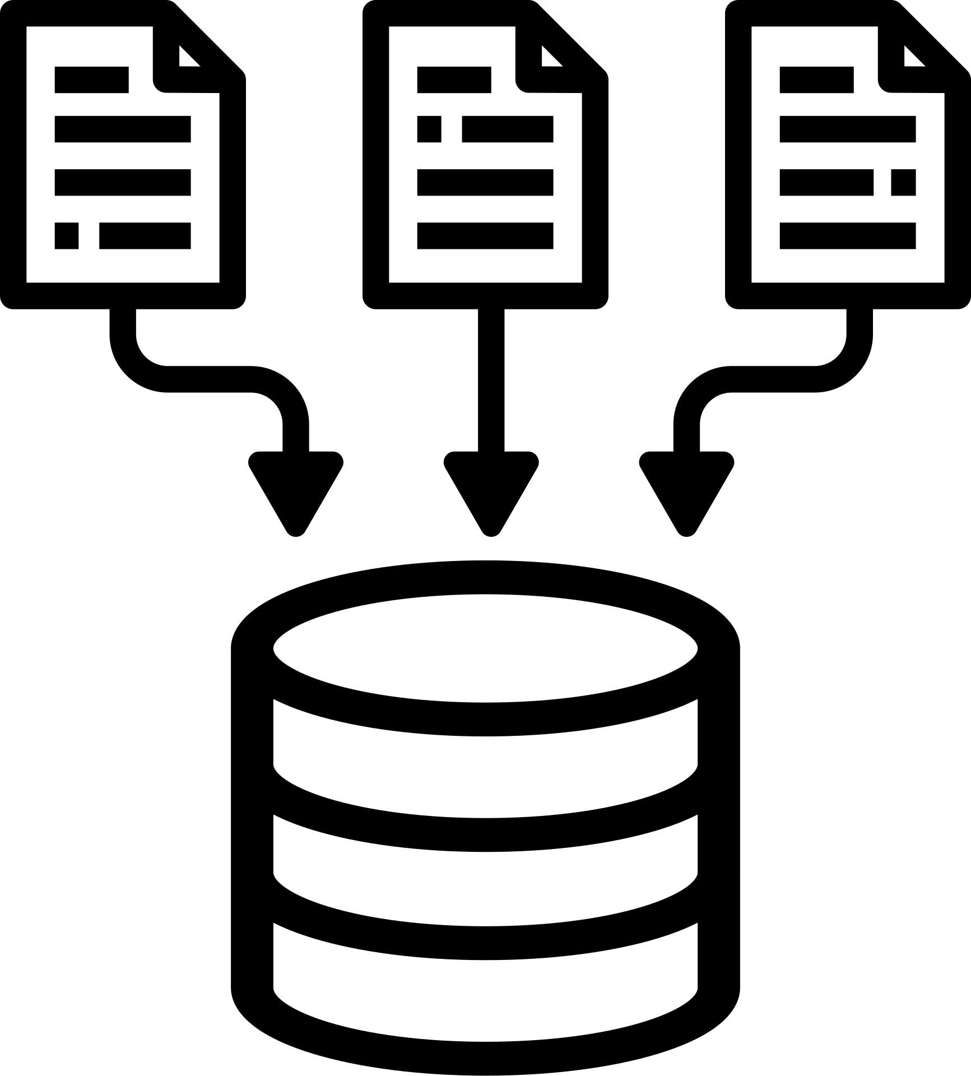


PROBLEMS & DIFFICULTIES
1. Reading the data from csv
2. Reading & Parsing the fields of dates from our CSV files and storing them in our database
3. Test files - Mockito
4. Typed Query use to non Primary key fields

Slide 8
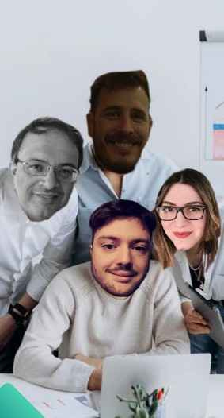






THE FUTURE WORK
DATA VALIDATION
MORE TESTS
USER INTERFACE (UI)
STORE DATA TO CSV FILES
FORMAT THE ENUMS IN DATABASE

Slide 9


LIVE DEMO

Slide 10


THANK YOU!

